Slide 1
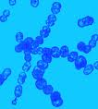
Sreptococci
Streptococci
G⁺ spherical bacteria forming pairs or chains during growth. They are widely distributed in the nature. Facultative anaerobes, catalase negative, non-spore forming. Some are members of the normal human flora. Others are associated with important human diseases.
Culture characteristics:
Most streptococci grow on solid media as descoid colonies, usually 1-2 mm in diameter. Strains that produce capsule give rise to mucoid colonies. Most strptococci are facultative anaerobes. Growth and haemolysis is aided by incubation at 10% CO₂ .
Most pathogenic streptococci grow at 37 ⁰C.Group D enterococci grow well at 15-45 ⁰C. Enterococci also can grow at 6.5% Nacl.

Slide 2
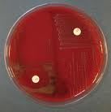
Colony variation
Different streptococci produce different colony forms:
B-hemolytic sreptococci produce matte, glossy, mucoid , translucent colonies (S. pyogenes, S. agalactiae, S.dysagalactiae, S. equi, S. canis)
Non-B- hemolytic streptococci produce small, mucoid, some are discoid (S. pneumoniae, S. equinus, S. Suis)
Non-hemolytic streptococci produce entire, circular, convex colonies (Enterococci)

Slide 3
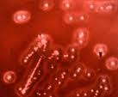
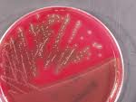
Colony morphology of streptococci

Slide 4
Classification of streptococci
Streptococci are a heterogeneous group of bacteria that no single classification system is sufficient to classify them. So classification based on many features including:
Hemolysis:
1. alpha-hemolytic: partial or incomplete hemolysis of RBCs ( e.g. Enterococci, pneumococci)
2.Beta-hemolytic: complete hemolysis of RBCs (e.g. St. pyogenes).
3. Non-hemolytic: No haemolysis of RBCs (e.g. St. viridance).
Group specific substance (Lancefield grouping): It depend on surface group-specific carbohydrate cell wall antigens.
A-H and K-V (animal pathogenic streptococci are in groups (A,B,C,D,E,G,L, & V)
Capsular polysaccharide: used in classification of pneumococci (84 types) and St.agalactiae.
Biochemical reactions: including sugar fermentation, presence of certain enzymes, susceptibility or resistant to certain chemical agents.

Slide 5
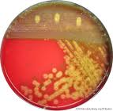
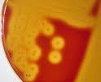
Alpha & beta hemolysis of streptococci

Slide 6
Toxins and enzymes of streptococci
More than 20 extracellular products are elaborated by group A streptococci including the followings:
* Streptokinase (Fibrinolysin):
It is a proteolytic enzyme that digest fibrin & other proteins produced by many strains of group A beta-hemolytic streptococci.
* Streptodornase:
Liquefy purulent exudate & facilitate spread of bacteria.
* Hyaluronidase:
It split hyaluronic acid which is an important component of the connective tissues, thus it aid in spread of bacteria.
*Erythrogenic toxin (Pyrogenic exotoxin):
Produced by group A streptococci. Three antigenic types A,B, and C. The streptococcal pyrogenic exotoxin are associated with streptococcal toxic shock syndrome and scarlet fever.
*Hemolysin:
Hemolyze RBCs in vitro in varying degree.
-Beta-hemolysis: complete hemolysis of RBCs
-Alpha-hemolysis: partial hemolysis of RBCs.
-Beta-hemolytic group A s. pyogenes produce two type of hemolysins, Streptolysin O and streptolysin S.

Slide 7
Laboratory diagnosis:
Specimens: It depends on the nature of streptococcal infection, include; pus, Throat swab, blood, vaginal swab, sputum, etc.
Direct smear: using Gram’s stain, G+ cocci arranged in chains
Culture: usually on blood agar plates or chocolate agar under 5-10% CO2.
Direct antigen detection test: It is a rapid agglutination test using specific antisera.
Serological tests: e.g. Anti-streptolysin O titer (ASOT).

Slide 8
Streptococcal diseases in animals
S. agalactiae :is the best known as a cause of chronic bovine mastitis. The bacteria also cause mastitis in sheep, goats & camels.
S. canis: causes genital, skin, & wound infection in dogs. It is commonly isolated from feline abscesses, metritis, mastitis & kitten septicemia. Neonatal kittens are infected via the umbilicus originated from vagina or oral colonization of queen.
S. dysagalactiae: causes bovine mastitis & skin lesion on the udder. Other species causes abortion, dermatitis & septicemia in cattle & dogs.
S. equi: causes strangles, genital infection & mastitis in horses. (strangles is a highly communicable infection of the URT associated with lymph nodes).

Slide 9
Streptococcus pneumoniae Diplococcus pneumoniae Pneumococci
G + lancet-shape diplococci possess polysaccharide capsule. On culture, a small round colonies at first dome-shape and later develop a central plateau with an elevated rim.
It produce alpha-hemolysis on blood agar.
Growth is enhanced by 10% CO₂ . More than 80 antigenic types according to capsular polysaccharide.

Slide 10
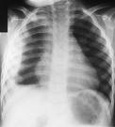
Pathological conditions:
St. pneumoniae produce no significant toxin, the virulence factor is a function of its polysccharide capsule which prevent phagocytosis by interfering with complement binding & mediating complement inactivation. The most common pathological conditions caused by St. pneumoniae are Pneumonia, sinusitis, otitis media, septic arthritis and meningitis. The onset of pneumococcal pneumonia is usually sudden with fever, chills & sharp pleural pain. The sputum is similar to alveolar exudate, sometimes bloody or rusty. Early in the disease bacteremia is present in 10-20% of cases. The mortality rate may reach up to 30% depending on age and underlying illness.

Slide 11
Laboratory diagnosis:
Specimens: including sputum, blood, pus, cerebrospinal fluid.
Gram’s stained smear: G+ diplococci
Capsule swelling test (Quelling reaction)
Culture:
On blood agar or chocolate agar
Antigenic detection by specific antisera.

Slide 12
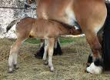
Diseases in animals
S.pneumoniae causes pneumonia in rats, mice, guinea pigs & calves. Bovine mastitis. Lower RTIs in young horses.

Slide 13
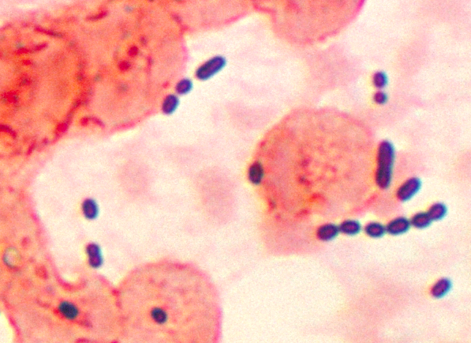
Enterococci
G+ cocci usually arranged in pair.
There are at least 12 species. St.fecalis is the most common and causes 85-90% of enterococcal infections. It is known to cause nosocomial infections particularly among immunocompromised patients. Transmission occur through hands of health care workers & fomites. Some people carry the enterococci in their gastrointestinal tract.
Enterococcal infections include urinary tract, wound infections, biliary tract and blood. Enterococci are known to develop a wide range of antibiotic resistance including vancomycin, aminoglycosides and beta-lactams due to production of beta-lactamase enzyme.

Slide 14
Colony morphology
On blood agar produce white, entire, convex colonies.
All species grow in the presence of 6.5% NaCl.
Ferment sorbitol
Bile esculin test positive

Slide 15
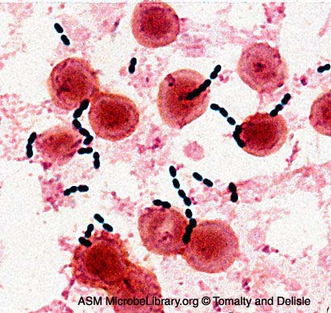
Disease in animal
E. avium: Septicemia in birds
E. durans: Septicemia in birds, neonatal diarrhea in calves, diarrhea in cats.
E. faecalis: septicemia & diarrhea in birds, UTI in dogs, mastitis in cattle.
E. faecium: Septicemia in birds
E. gallinarum : Septicemia in birds

